Slide 1
ENGI 301 Laser-activated guitar
2/19/2024
Guido Domenico De Santis

Slide 2
Background Information
I listen to music all the time but I can’t play any instrument. I stumbled across some projects on hackster.io that regarded lasers and how they are used to produce music since I am doing research with a professor on some special kinds of lasers. Then I saw this project on a guitar activated by laser diodes and I thought that it would be a good challenge to try to replicate it.
Here is the link: https://www.hackster.io/samnaji/laser-guitar-1686f0

Slide 3
System Block Diagram
PocketBeagle
PWM
2 BUZZERS
POWER
BATTERY
GND
AIN
POTENTIOMETER
2 LASER DIODES
VIN
VIN
2 DETECTORS

Slide 4
Power Block Diagram
PocketBeagle
PWM
2 BUZZERS
POWER
5V BATTERY
GND
AIN
POTENTIOMETER
2 LASER DIODES
SYS 5V
SYS 5V
2 DETECTORS

Slide 5
Components / Budget
Component | ENGI301 to Buy? | Cost
https://www.amazon.com/HiLetgo-10pcs-650nm-Diode-Laser | YES | 6.79
https://www.amazon.com/Onyehn-VL53L0X-Breakout-GY-VL53L0XV2-Distance/ | YES | 11.69
https://www.newark.com/lprs/n5ac501085/ldr-5mohm-50mw-ng-series/dp/14J5050?COM=ref_hackster&CMP=Hackster-NA-project-1686f0-Feb-24 | NO | 2.09
See Next Slide for Instructions

Slide 6
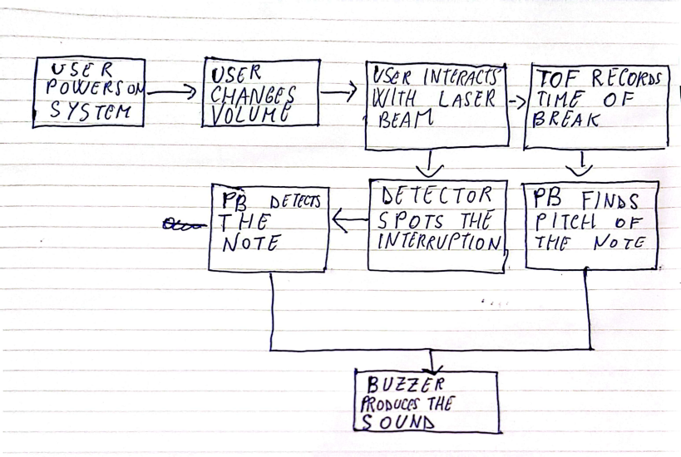
Software Diagram

